Slide 1
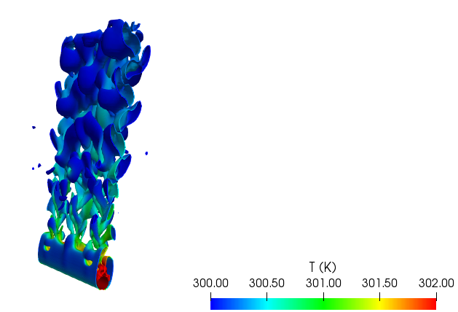
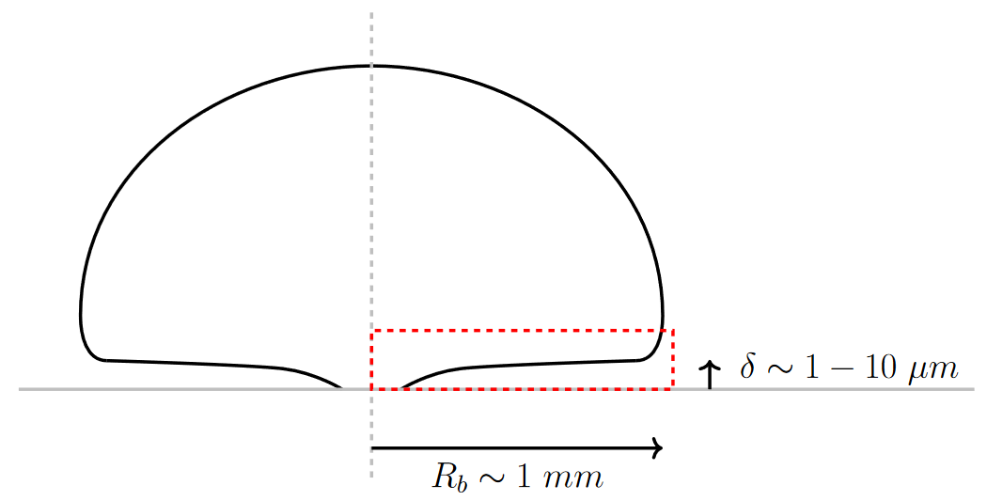
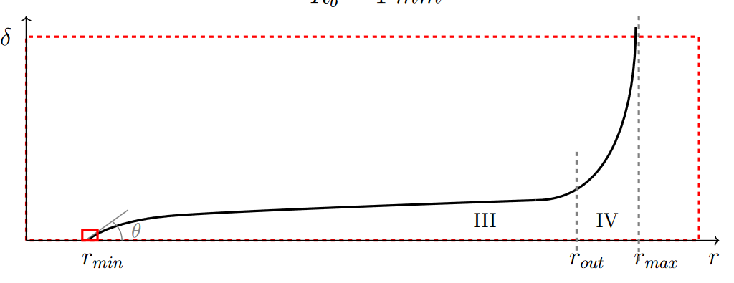
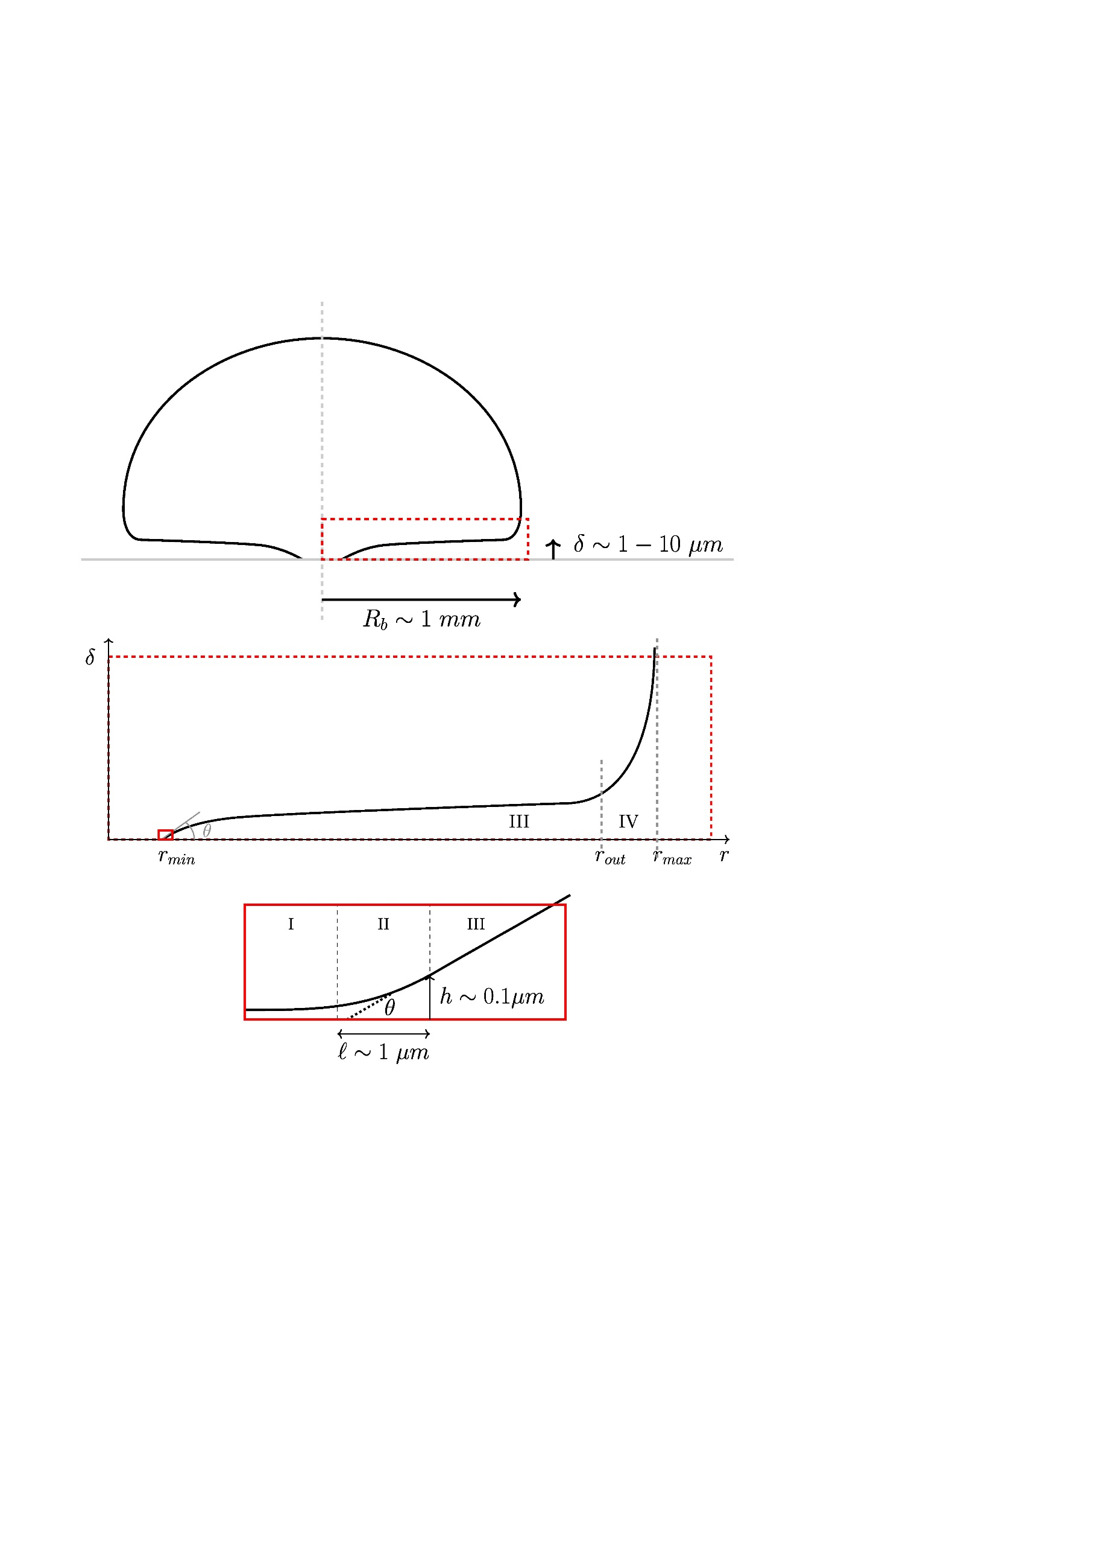
Ph.D. thesis in modeling two-phase flows using efficient multi-scale phase change closure methods: contact line effect
Ph.D. position supported by INTREE Graduate School
Presentation / Introduction
Pprime Institute (P’) is a renowned research laboratory specialized in the fields of Physics and Engineering Sciences. It is a CNRS institution linked with the University of Poitiers (The Faculty of Fundamental and Applied Sciences, ENSIP (National Higher School of Engineers of Poitiers)) and ISAE-ENSMA (National Higher School of Mechanics and Aerospace Engineering).
COST team aims at studying the non-adiabatic flows/media with or without radiative coupling (natural and mixed convection, aerothermal, turbulence, thermo-solutal instability, radiation and double diffusion convection) as well as the development and system integration of cooling solutions using two-phase flows with or without
phase change. In these two areas, research is also led with an approach of optimization and control of transfers (cooling of engine elements, compact systems, power electronics, control of the quality of the atmosphere in passengers compartment, etc.).
GENERAL CONTEXT
EXPECTED DEVELOPMENTS
The high integration and densification in power electronics and new carbon-free engine (due higher adiabatic flame temperature) in aeronautics and transport present increasing challenges for more efficient heat control and cooling means for which phase change systems are a good candidate. One of the possible solutions to be used are passive two-phase loops, in which heat transfer is associated with the change of state of the fluid. The loop is illustrated in Fig. 1. It consists of a closed duct partially filled with a liquid in a close-to-thermodynamic-equilibrium state with its vapor phase.
For the latter work, the moving interface is captured by the Volume-of-Fluid method and advected by the isoAdvector Algorithm. Among the plethora of change phase models available in the literature, a hybrid model was chosen: a sub-grid model to enable the phase change close to the wall (if appropriate) in the absence of resolved interfaces, and an explicit liquid-vapor phase change model applicable at resolved liquid-vapor interfaces. The hybrid model was implemented successfully using OpenFOAM library and two-dimensional simulations showed that the model so-developed is able of reproducing the main flow regimes obtained experimentally, such as Taylor bubble formation and liquid propulsion of the evaporator towards the condenser during boiling in geyser. The loop performances predicted by the model are also in fair accordance with well-documented cases.
Yet, many issues remain unanswered to date. First, the present model is extremely computer resources consuming. Although the model being dimension-free, performing a full three-dimensional simulation of the whole loop is at the present time out of reach, indeed. Therefore, optimized algorithms for efficient interface advection are sought for. Then, liquid film and/or vapor film dynamics close the contact line (or micro-region) is lacking in the present model, see Fig. 2. Bearing in mind that the heat transfer is largely enhanced close to this line, an appropriate representation of this phenomenon is of paramount importance and is definitely a step forward to a more realistic loop model. In addition, a more accurate scheme has to be developed in order to enhance the mass conservativeness in compressible flow context. Finally, some minor improvements have to be done in order to take into account Kelvin effect for example, i.e., the departure from saturation conditions whenever the interface is no longer planar, the recoil pressure, etc. Test cases for validation are available from both Pprime Institute experimental data and literature. Using the developed tool, original loop can be designed and assessed afterward.
Fig. 1. Sketch of a two-phase loop thermosyphon (TPLT)
Once charged, i.e., heated from a side called the evaporator and cooled from another called the condenser, the fluid onsets a motion due to phase change and buoyancy. The motion insures the super-heat transfer capabilities of such a device. The main issue to address is usually how to design the device in a way that it reached its lowest thermal resistance, shortest response time, lowest noise, highest resilience to failure and largest working stability. Flexibility may also be a variable to consider. To assess such a device, modeling effort has to be made and worth noticing that robust and reliable models at the device scale are quite scarce. Nevertheless, Pprime Institute has put considerable efforts to develop a two-phase flow model with either mixed or separated phases. These models were able to simulate a two-phase gravity loop. This has been possible in a first step using a one-dimensional mixture model and lastly using a three-dimensional segregated model.
Fig. 2. Scales involved in bubble growth. (From left to right: bubble, liquid film and micro-region scales.)
Skills sought for
You should have earned excellent grades and hold a Master of Engineering or a Master of Science in Mechanics, Aeronautics, Aerospace or Applied Mathematics
Mandatory skills:
1. Good knowledge of PDE for fluid mechanics/heat and mass transfer
2. Good knowledge of Numerical methods/computation
3. Good practice of symbolic calculus
4. Good knowledge of Python scripting language
Optional (but useful) skills:
1. Knowledge of asymptotic developments
2. Basic knowledge of openFOAM library
3. Knowledge of C or C++ language
CONTACT: application should be sent to:
etienne.videcoq@isae-ensma.fr
adel.benselama@isae-ensma.fr
International applications are welcome
SALARY: between 2100 and 2300 € gross per month
Ph.D. duration: 36 mouths
Start time: October 2024 or a.s.a.p. after
Information for accommodation: https://www.euraxess.fr/
Hosting international students: marie.amelie.masselin@univ-poitiers.fr (visa issues, health care coverage, nursery or school for children, etc.)

